Slide 1
Project Presentation
Performance Analysis and Modeling of Software Systems, Fall 2018
Ettore Puccetti
ettore.puccetti@alumnos.upm.es

Slide 2
Implementation HTML tag cleaning
String line = … < chars to ignore > chars to save < …
For chars in line {
if (!tagOpened) {
result.append(chars)
}
}
tagOpened = True;
tagOpened = False;

Slide 3

Server
Back to client
Initialize data structure
Accept clients connection
Read client string
Build request and push in the requestQueue
Dispatcher
Workers
From
client
- Count
- serialize
1
ThreadIndex
Request
ClientID % m
…
…
ThreadIndex
Request
m
requestQueue
Request = < String, ClientID, SocketChannel >

Slide 4
System Stability
Multithread with 8 worker threads
Document size fixed to 4KB
Decreasing number of repetition while increasing number of clients (from 200k to 50k)
Number of clients from 1 to 16 (averaging the throughput for plotting)

Slide 5
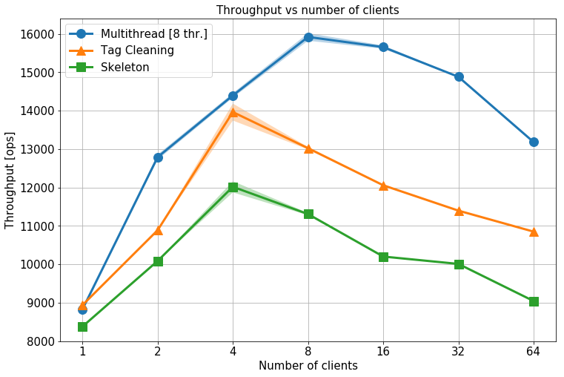
Baselines

Slide 6
Effect of Document Size
Bottleneck:
Counting task

Slide 7
Conclusion
Elaborate shortly on
What did you learn about the system through experiments?
What new skill did you learn while working on the project?
What was the most difficult aspect of the project?

